Slide 1
Suggestions on Curriculum review ( Paed Nephrology)
Dr WM Lai on behalf of HKPNS
10/2022

Slide 2
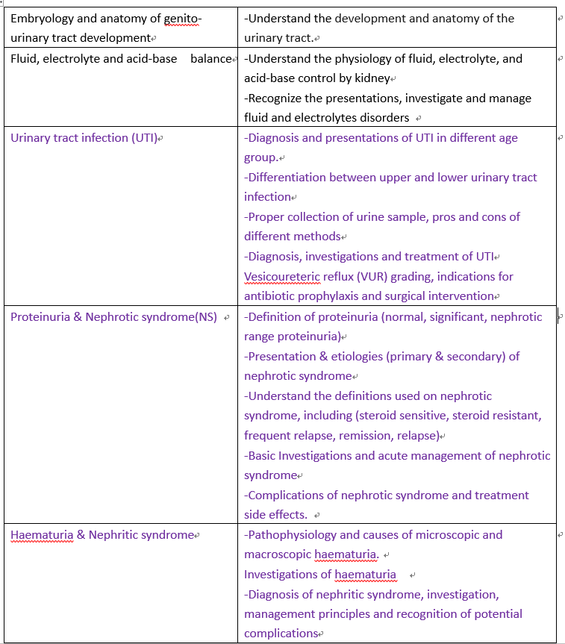
Basic training

Slide 3
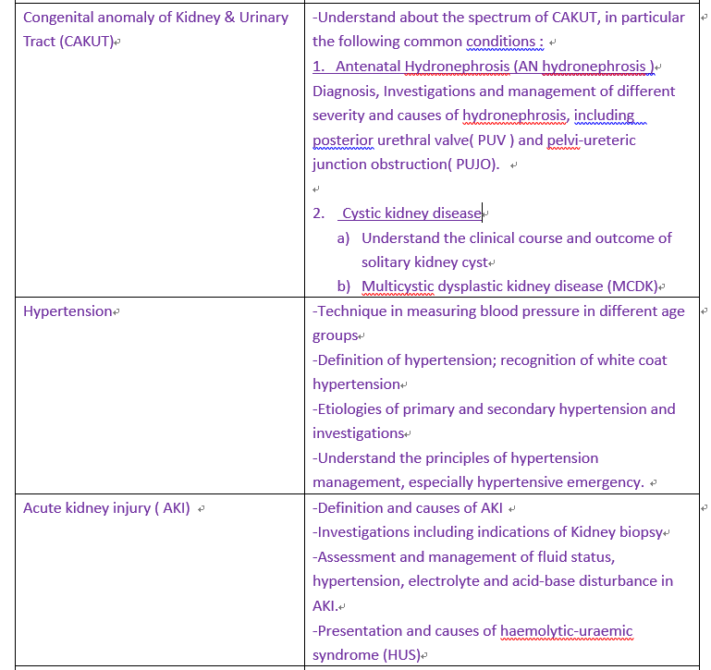

Slide 4
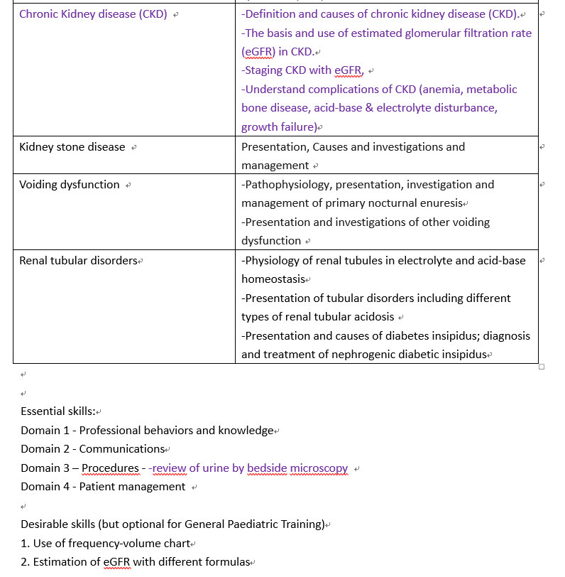

Slide 5
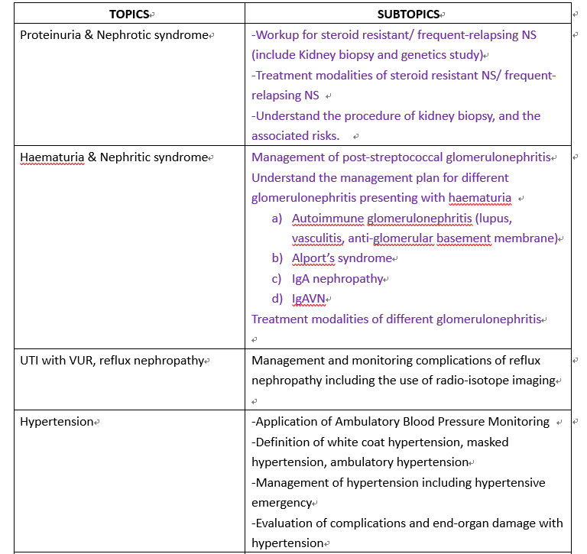
Higher training

Slide 6
